Slide 1
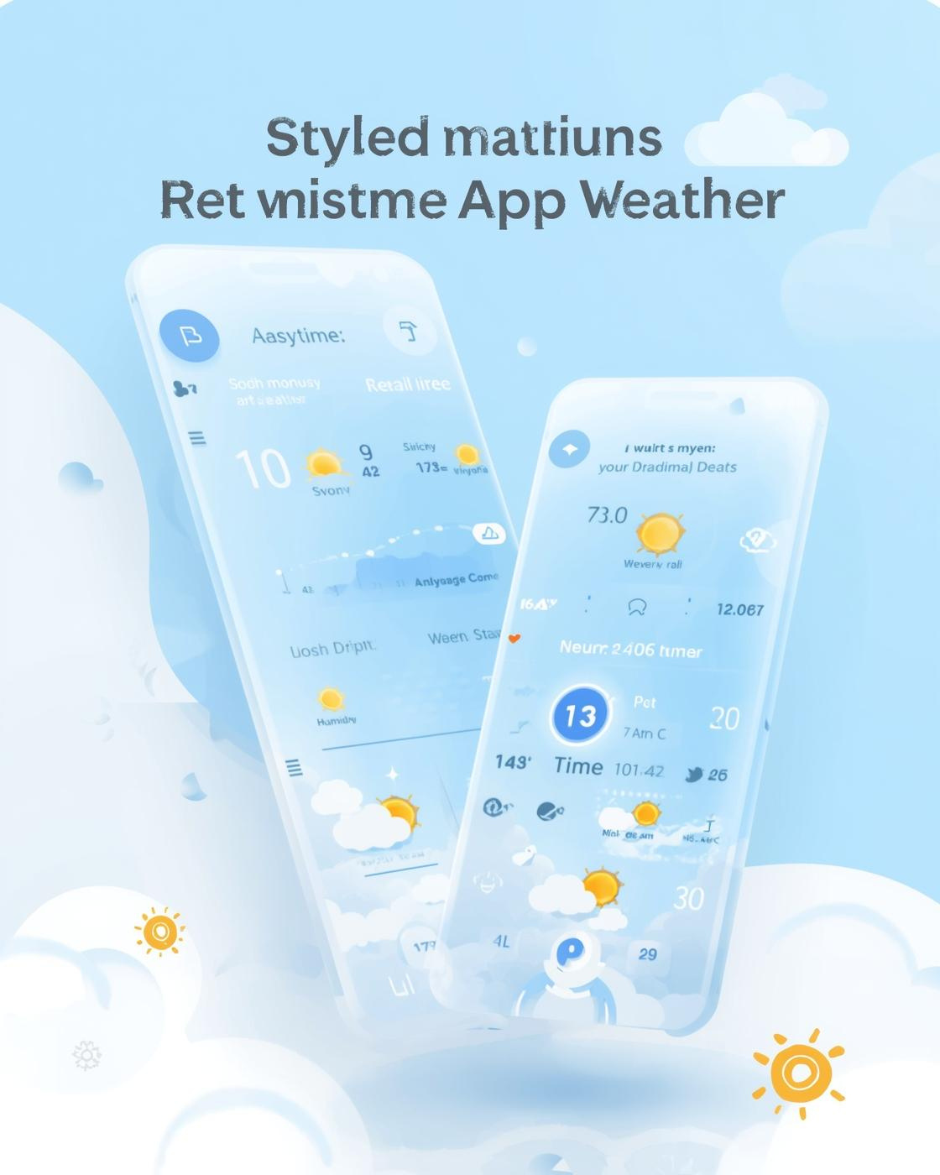

Weather Web Solutions
Weather Web Application
Real-time Weather Forecast & Map
January 3, 2026, 10:00 AM, Online Presentation

Slide 2

Team & Project Overview
Meet the talented group behind the Weather Web Application project
Our diverse team collaborated to create a user-friendly web app that provides real-time weather data and forecasts for any location worldwide.
2

Slide 3

Core Features
City Search
Current Weather
Quickly find weather data for any city worldwide.
Get real-time details like temperature and humidity levels.
Forecasts
Interactive Map
View hourly and 5-day weather forecasts at a glance.
Explore detailed weather patterns using an interactive map feature.
3

Slide 4

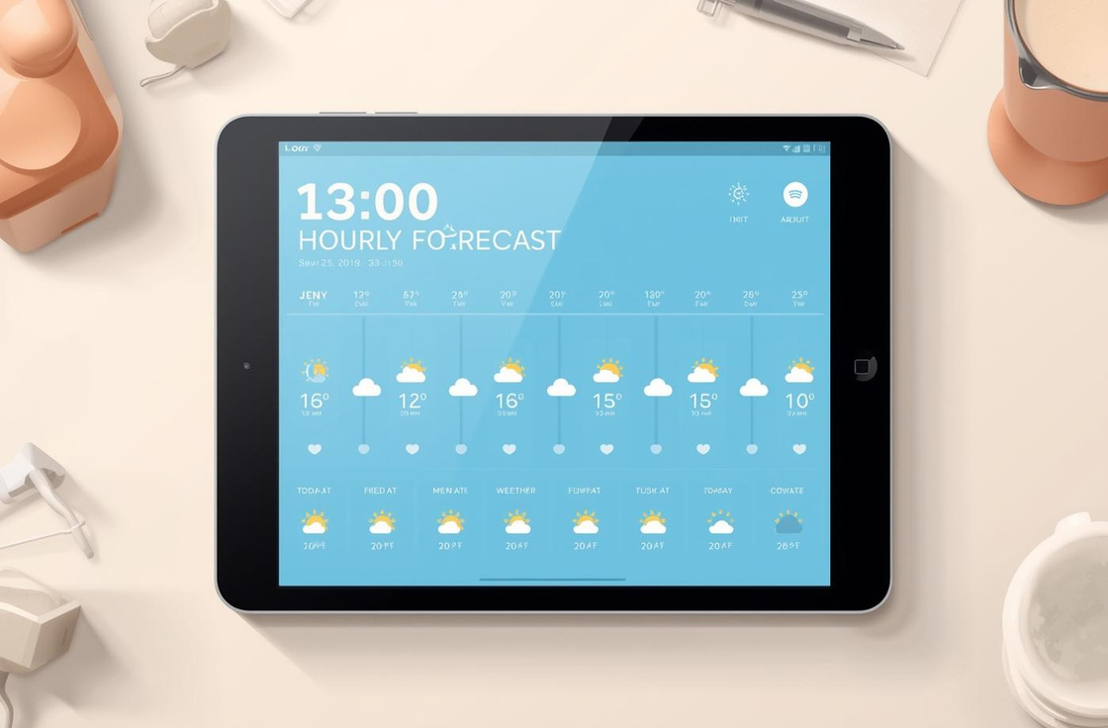

Explore the Weather App Demo
Go to Weather Web
4

Slide 5
Key Challenges Faced
Connecting to API
Handling Errors
Displaying Data
Establishing a stable connection to the weather API was challenging.
Managing API errors and ensuring user-friendly feedback proved difficult.
Presenting complex weather data clearly without overwhelming users was crucial.
Responsive UI
User Experience
Ensuring the user interface worked seamlessly across devices was essential.
Balancing functionality with a simple, intuitive design for users was vital.
5

Slide 6
Solutions Overview
OpenWeather API
Error Handling
Data Organization
We correctly integrated the OpenWeather API for accurate weather data.
Implemented error handling for invalid inputs to improve user experience.
Organized weather data into user-friendly cards and sections for clarity.
Responsive Design
User Feedback
Applied CSS and Bootstrap for a fully responsive layout on all devices.
Incorporated user feedback to continuously enhance features and functionalities.
6

Slide 7
What I Have Learned
Working effectively with APIs and data
Enhancing JavaScript logic for better performance
Designing user-friendly and engaging interfaces
Gained experience in fetching and handling data
Improved skills in writing efficient code logic
Developed expertise in creating intuitive layouts
7

Slide 8
Conclusion
Summary of Project and Experience
In this project, I gained valuable skills in API integration, user interface design, and problem-solving. Thank you for your attention, and I welcome any questions you may have.
8

